Slide 1
Research Progress & Updates
By: Daniel Leskiewicz

Slide 2
Project Topic
Exploring approaches on predicting TF-DNA motifs binding pairs.

Slide 3
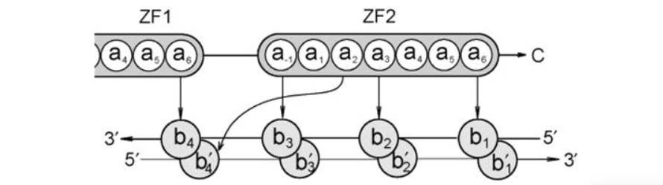

Learning the ‘canonical’ Model
The Structural Model
The Pattern
Notes:
Notes:
The Structure Model : So there are studies that suggest that this ’canonical model’ interface can help with prediction of the DNA-binding preferences of computational approaches. The way that the canonical model interacts is that each finger (Zinc finger) contacts DNA in a antiparallel (it parallel but not in a straight line necessarily) manner. So basically, from this we can visualize each Zinc finger fits into a spot onto the DNA, and these fingers contact four base pairs within the DNA. Within this first paper, the authors mentioned/identified 4 amino acid positions that contact DNA. These positions are referenced to the start of the DNA strand while one of the positions contact the complementary DNA strand.
The Pattern: The authors used this pattern to identify zinc finger proteins. This pattern was really inconsistent with the data that we received from them. The pattern either wasn’t fully consistent with some of the zinc finger samples or didn’t really apply to the protein at all.
- This pattern was used to get the correct positioning of the amino acids into the -1,2,3 and 6 positions

Slide 4
Technical Aspects Of The Paper
Database
Gathering Samples
SVM’s
Linear Kernel
Polynomial Kernel

Slide 5
The K-mers Approach
Utilization of k-mers using models within sklearn
In this case we are using k-mers testing the length of different k
These k-mers are more so describing binding sites and we can cover a discrete space of all possible DNA molecules of length k.

Slide 6
Models Implemented with Kmers
Logistic Regression
Random Forrest
MLP (Multi Layer Perceptron)

Slide 7
Results From Logistic Regression

Slide 8
Results From Random Forrest Classifier

Slide 9
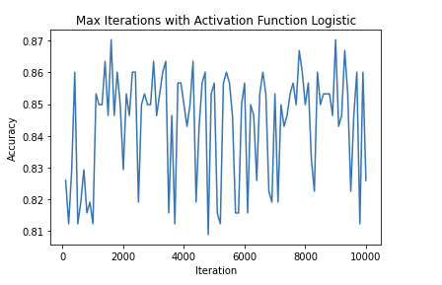
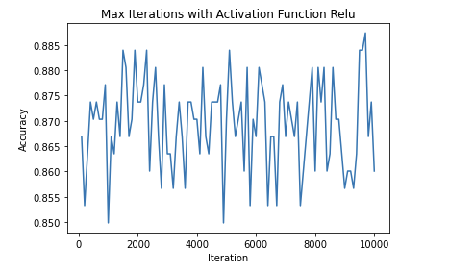
Results form MLP
Activation Function=‘logistic’, solver=‘adam’, alpha=0.0001
Activation Function=‘relu’, solver=‘adam’, alpha=0.0001

Slide 10
Main Progress within the Winter Term
Reading and summarizing different paper for most of the term
Trying to learn the biology required to understand the paper(s)
Last few weeks was trying to understand how to implement the author initial paper.

